Slide 1
Phylum Mollusca
BIO 2215
Oklahoma City Community College
Dennis Anderson

Slide 2
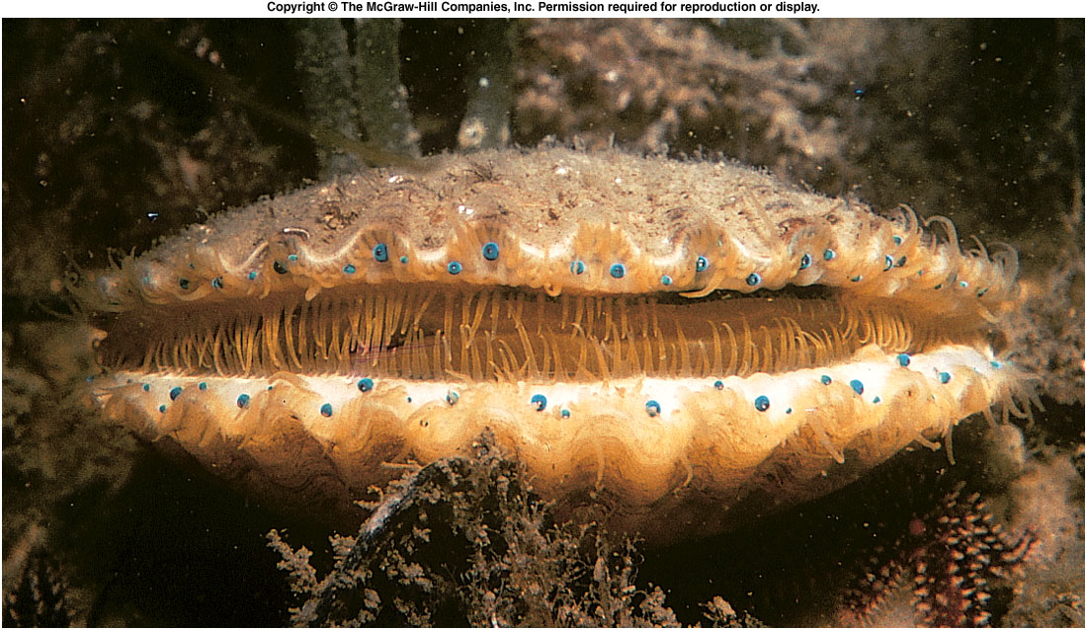
Phylum Mollusca
Notes:
Fig. 16.25

Slide 3
Numbers of species
Arthropoda
Mollusca
Chordata
Platyhelminthes
Nematoda
Annelida
Porifera
Echinodermata
Other
Sarcomastigophora
Apicomplex
Ciliophora

Slide 4
Molluscs
50,000 -100,000 living species
35,000 extinct species
Largest = 1000 pounds
80% less than 5 cm
Soft body
Most have a shell
Most marine
Snails terrestrial
  Most habitat

Slide 5
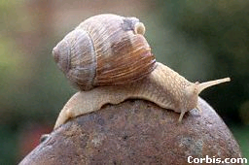
Phylum Mollusca
Ventral Foot
  Locomotion
Mantle
  Encloses mantle cavity
Shell
Radula
Coelom (eucoelomate)
Metanephridia
Open circulatory system
  Closed in cephalopods

Slide 6
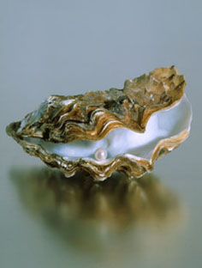
Economics
Pearls
Burrowing shipworms
Snails & slugs
  Garden pests
  Food
  Intermediate hosts for parasites

Slide 7
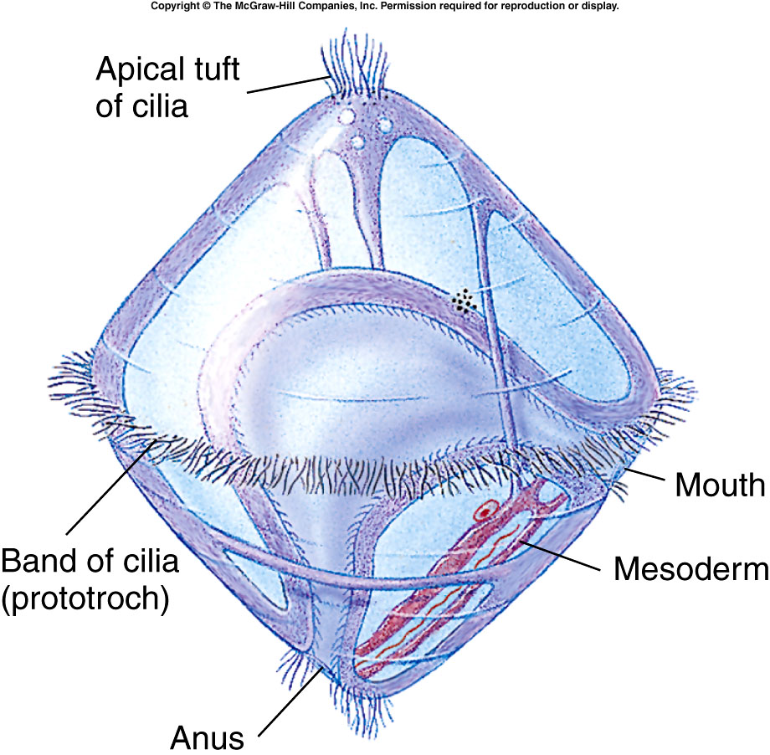
Trochophore Larva
Same type as Phylum Annelida

Slide 8
Echinodermata
Uniramia
Vertebrata
Chelicerata
Lophophores
Other Chordata
Crustacea
Arthropoda
Annelida
Hemichordata
Mollusca
Other
pseudocoelomates
Nemertea
Platyhelminthes
Nematoda
Ctenophora
Cnidaria
Mesozoa
Placozoa
Sarcomastigophora
Ciliophora
Porifera
Apicomplexa
Microspora
Myxozoa

Slide 9
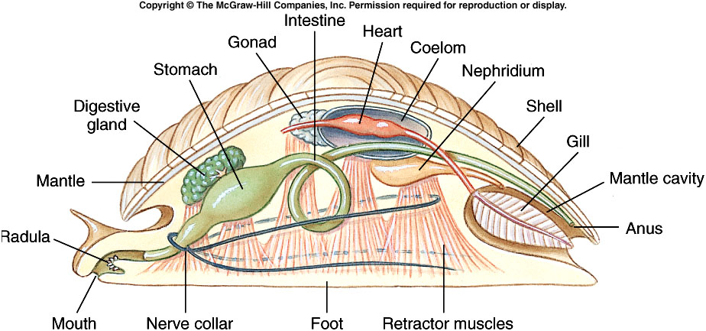
Generalized Mollusc
Notes:
Fig. 16.2

Slide 10
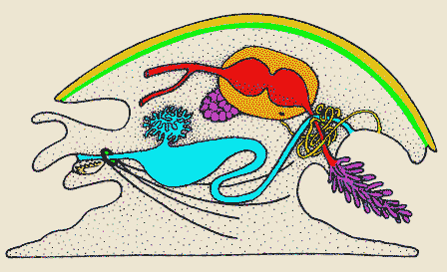
Body Plan
Pericardial cavity
Metanephridium
Mantle cavity
Gonad
Ctenidium
Radula
Foot
Stomach and digestive gland

Slide 11
Dorsal mantle covers the visceral mass.

Slide 12
Secretes the shell

Slide 13
Ctenidium (Respiration)

Slide 14
Complete digestive system

Slide 15
Paired ventral nerve cords

Slide 16
Radula

Slide 17
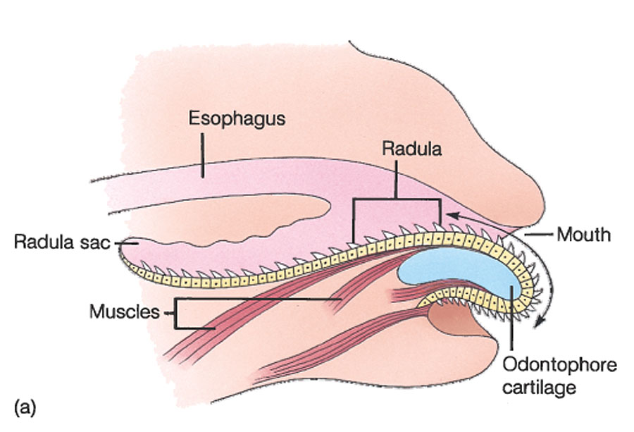
Copyright © The McGraw-Hill Companies, Inc. Permission required for reproduction or display.
Radular Structure
Source: From A Life of Invertebrates, Copyright © 1979 W. D. Russell-Hunter.

Slide 18
Coelom - metanephridia

Slide 19
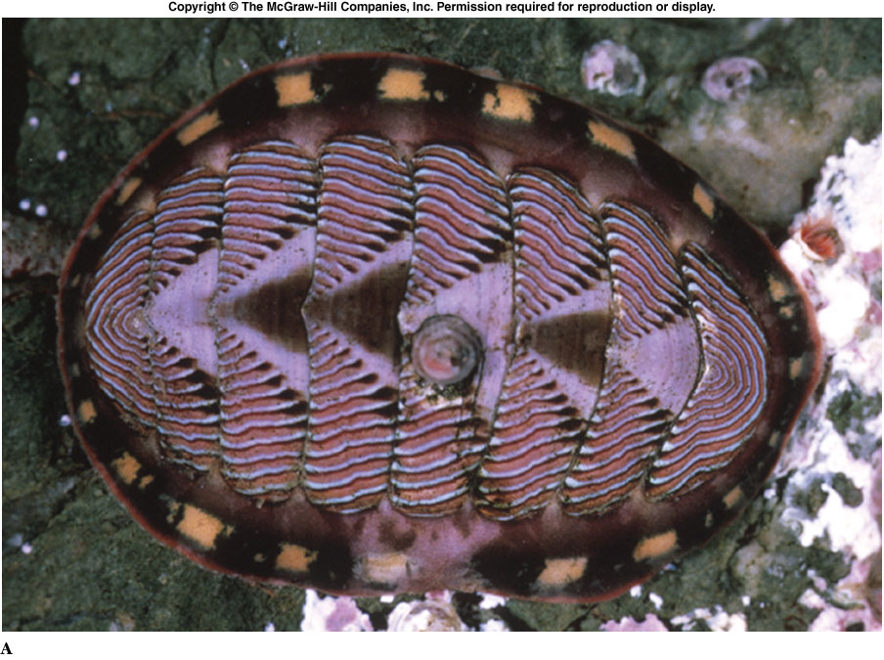
Class Polyplacophora
Chitons
Notes:
Fig. 16.1a

Slide 20
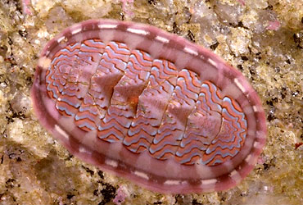
Class Polyplacophora
Eight dorsal plates
Reduced head
Radula reinforced with iron
  Scrape algae from rocks

Slide 21
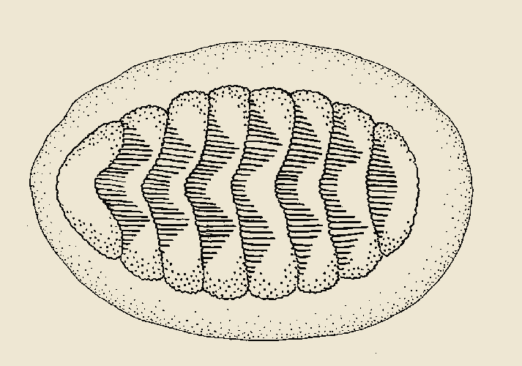
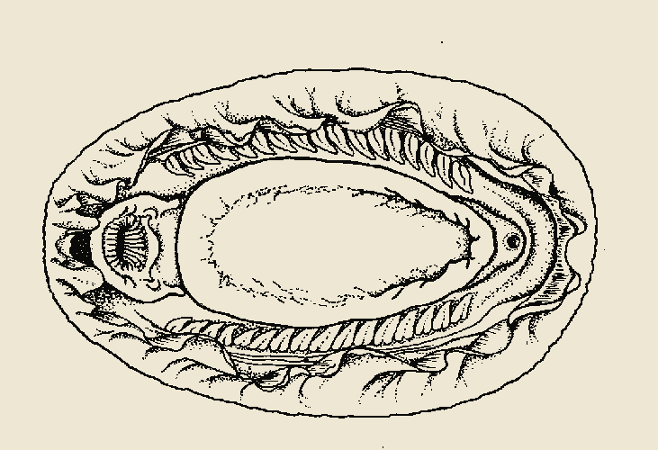
Class Polyplacophora
Mouth
Mantle cavity
Ctenidium
Foot
Anus

Slide 22
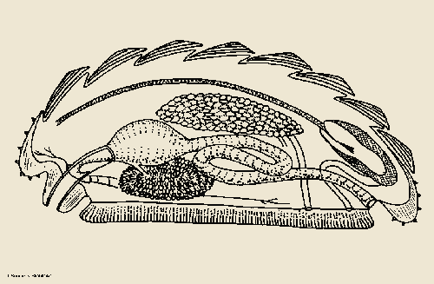
Class Polyplacophora
Stomach
Gonad
Digestive
gland
Pericardial cavity
Mouth
Nephridium
Anus

Slide 23
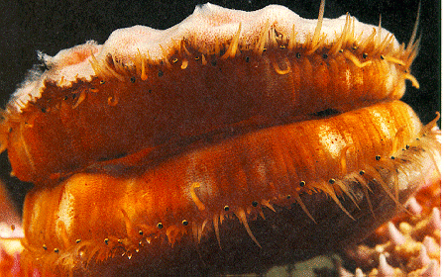
Class Bivalvia
Clams, Oysters, Shipworms

Slide 24
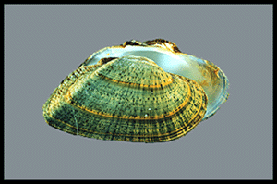
Class Bivalvia
Two shells
Most are filter feeders
No head or radula
Burrow
  Sand, wood, rocks

Slide 25
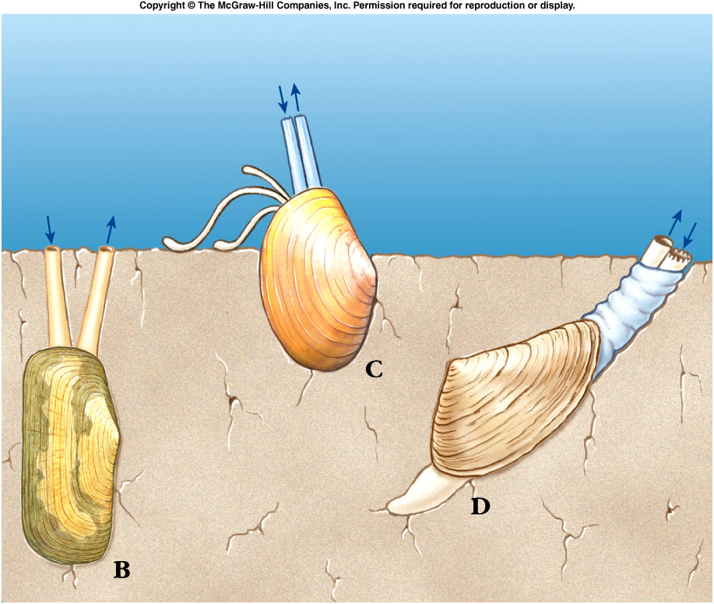
Notes:
Fig. 16.28b

Slide 26
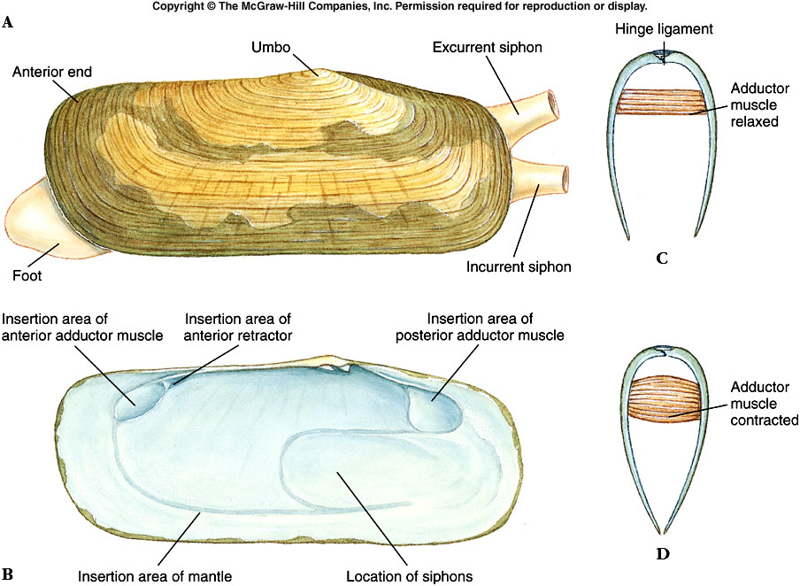
Notes:
Fig. 16.26

Slide 27
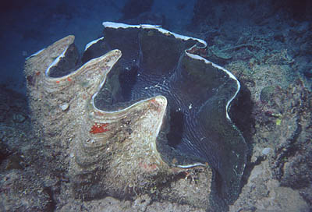
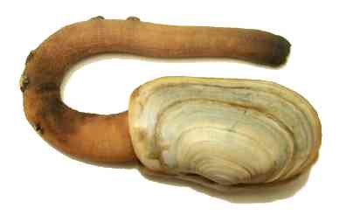
Giant Clam & Burrowing Clam
Siphon

Slide 28
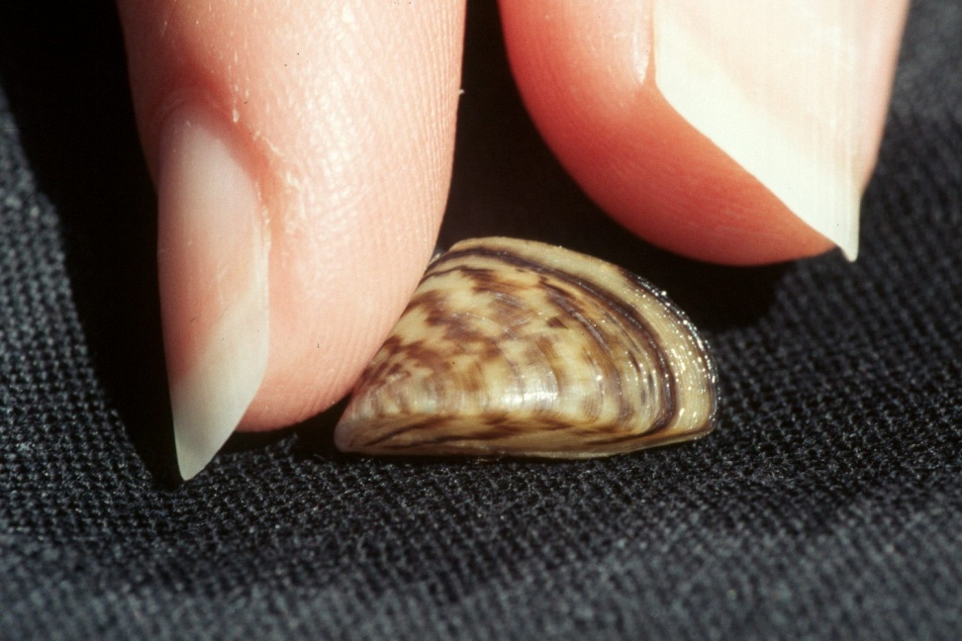
Zebra Mussel
Environmental Pest
Ballast water of ships from Europe in 1986
Attack be secreting adhesive byssal threads
  Each other
  Other mussels
  Man made objects
    Pipes, plumbing

Slide 29
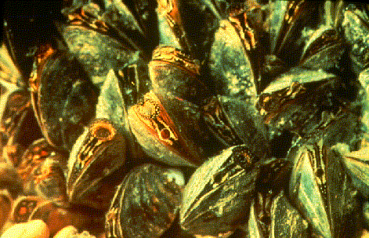
Zebra Mussel
Live in high densities
Feed on phytoplankton
Reproduce rapidly

Slide 30
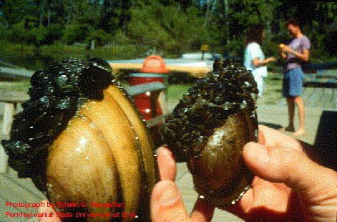
Zebra Mussel
Attach to native mussels
Killed all native mussels in Lake Erie

Slide 31
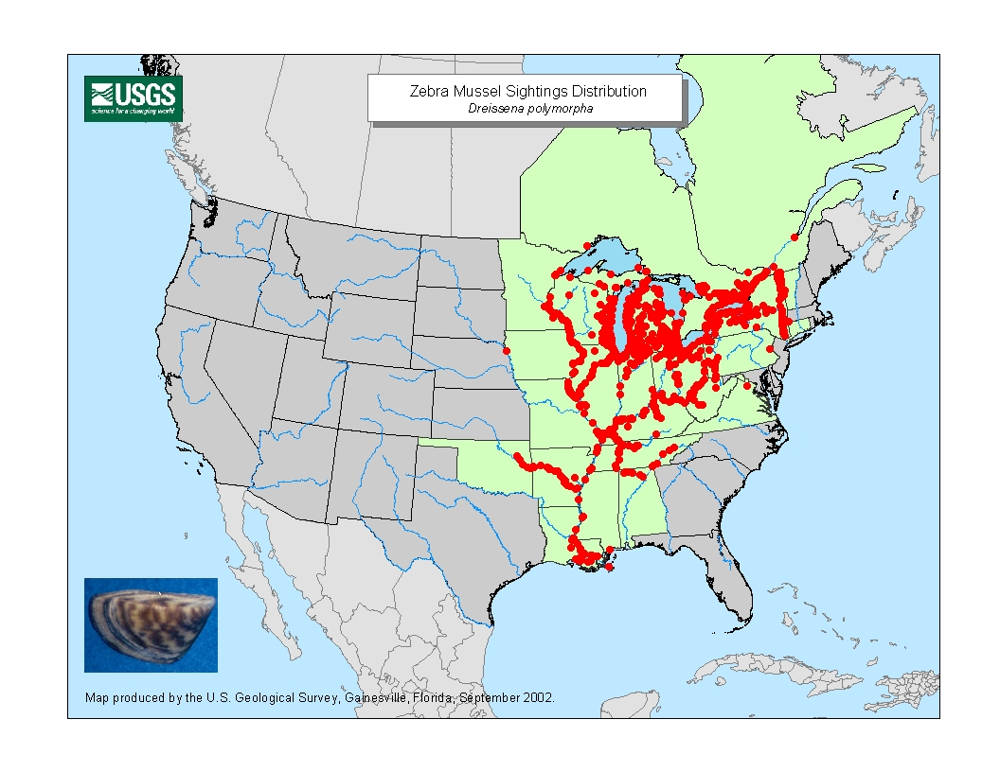
Distribution of Zebra Mussel

Slide 32
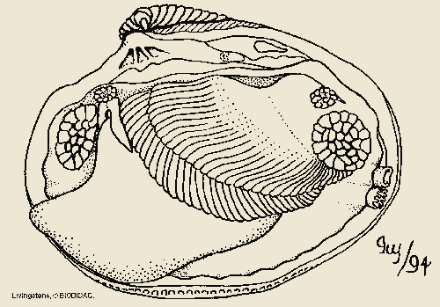
Bivalve structures
Hinge
Labial palp
Ctenidium
Excurrent
siphon
Foot
Incurrent
siphon

Slide 33
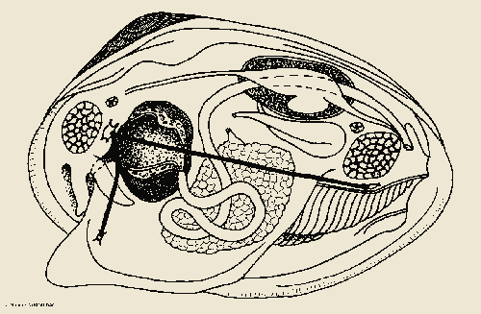
Clam anatomy
Pericardial cavity
Metanephridium
Heart
Intestine
Excurrent
Stomach
Incurrent
Intestine
Gonad

Slide 34
Clam anatomy
Digestive
gland
Excurrent
Stomach
Incurrent
Intestine
Gonad

Slide 35
Clam anatomy
Pericardial cavity
Heart
Intestine
Excurrent
Incurrent

Slide 36
Clam anatomy
Metanephridium
Pericardial cavity
Heart
Intestine
Excurrent
Incurrent
Gonad

Slide 37
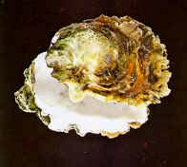
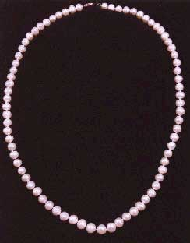
Oysters

Slide 38
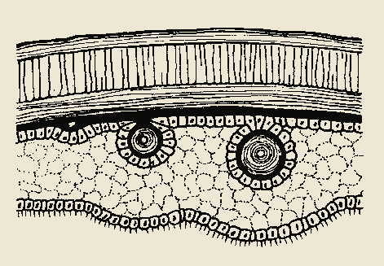
Pearl formation
Shell
Developing pearl
Epithelium
Irritant lodged between shell and mantle
Layers of nacre secreted around foreign material

Slide 39

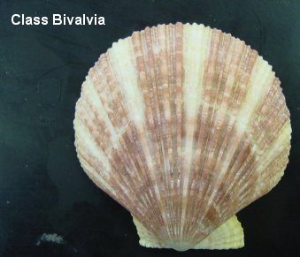
Scallops

Slide 40
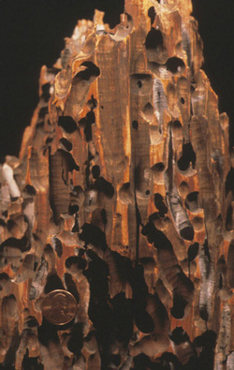
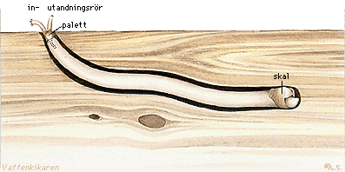
Shipworms

Slide 41
Class Gastropoda
Snails, Slugs, Conchs, Limpets

Slide 42

Class Gastropoda
One shell (if present)
Torsion of body

Slide 43
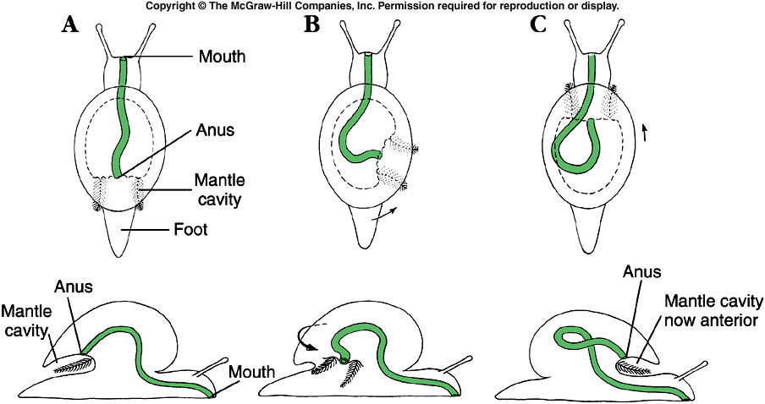
Notes:
Fig. 16.13

Slide 44
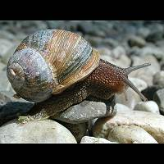
Snail
Terrestrail
Mantle cavity functions as lung

Slide 45
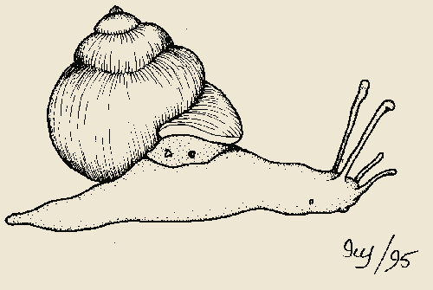
Snail
Pneumostome
Shell
Tentacle
(Eye stalks)
Anus
Tentacle
Foot
Mouth
Genital pore

Slide 46
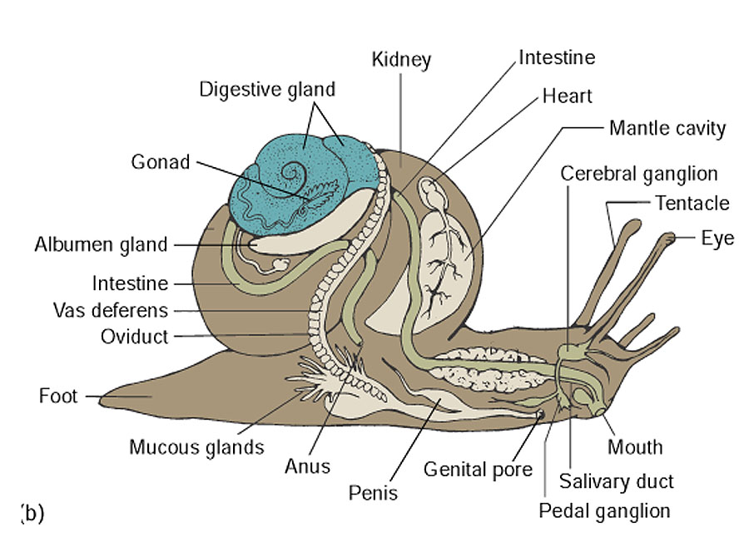
Copyright © The McGraw-Hill Companies, Inc. Permission required for reproduction or display.
Internal Structure of a Generalized Gastropod

Slide 47
Nudibranch
No shell
Dorsal projections
  Gills
  Nematocyst discharge

Slide 48
Abalone
Several holes in top of shell
  Excrete waste
Food for man

Slide 49
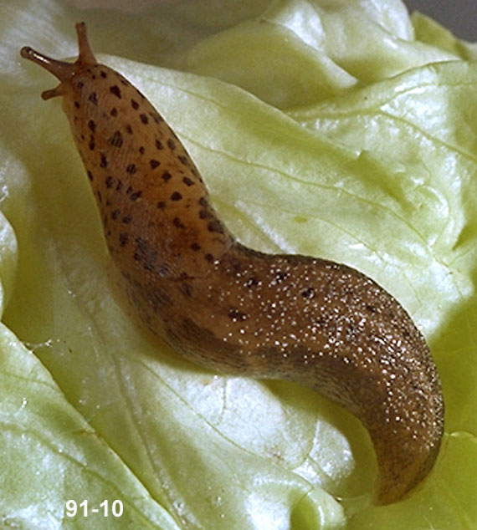
Slug
No shell
Garden pests

Slide 50
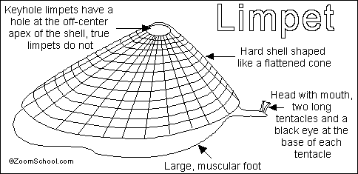
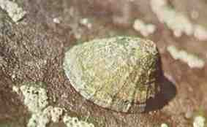
Limpet
Herbivores
Cling to rocks or other surfaces

Slide 51
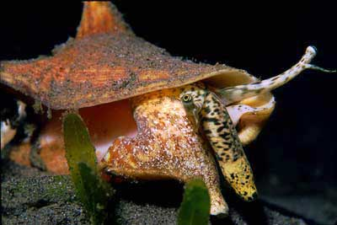
Conch
Large shell
Marine
Many are predators

Slide 52
Class Cephalopoda
Squids, Octopuses, Nautiluses

Slide 53
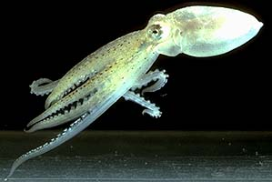
Class Cephalopoda
Shell in squid and octopus absent or vestigial
Jet propulsion
Ink sac
Foot modified into arms and tentacles
Marine
All predators

Slide 54
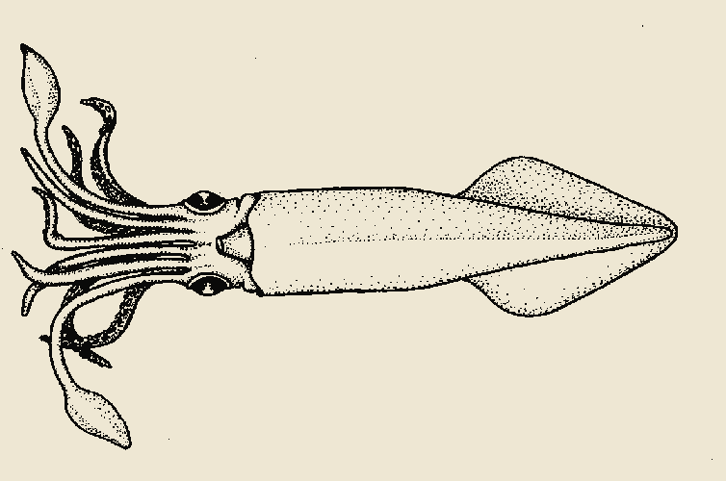
Squid
Posterior surface
Right
Ventral
Dorsal
Left

Slide 55
Squid
Tentacle
Arm
Funnel (siphon)
Collar
Fin
Eye

Slide 56
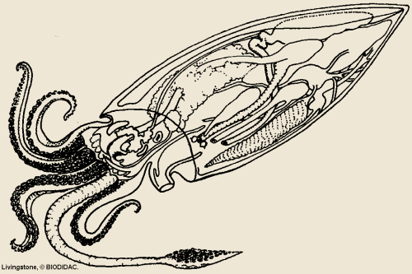
Squid
Shell (Pen)
Systemic
heart
Branchial heart
Ctenidium
Funnel
Notes:
4

Slide 57
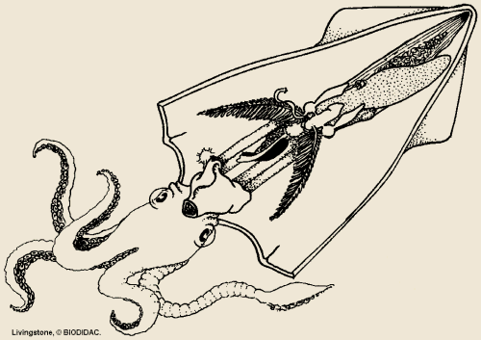
Squid Male
Testis
Penis
Hectocotylous arm

Slide 58
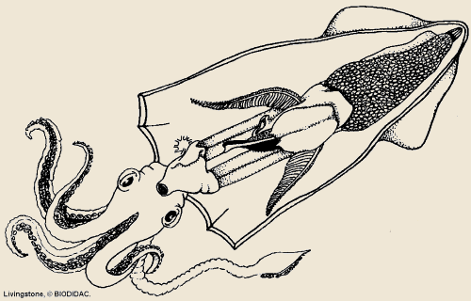
Squid Female
Ovary with eggs
Oviducal gland
Nidamental glands
Oviducal opening

Slide 59
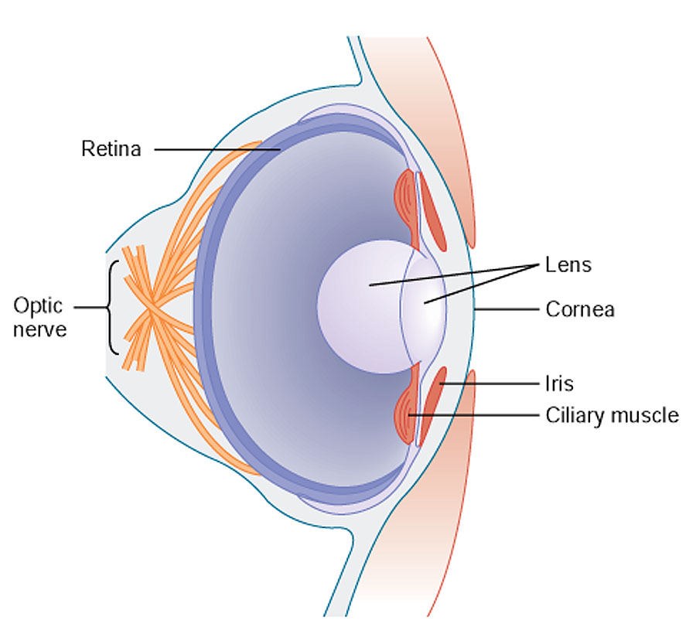
Copyright © The McGraw-Hill Companies, Inc. Permission required for reproduction or display.
Cephalopod Eye

Slide 60

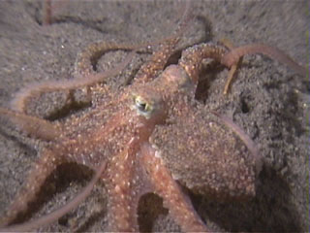
Octopus
Eight arms with suckers
Crawl or eject water from siphon
Change skin color
  chromatophores
Most intelligent invertebrate

Slide 61
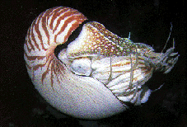
Nautilus
Up to 94 tentacles
  No suckers
Shell with many chambers
  Lives in outermost chamber

Slide 62
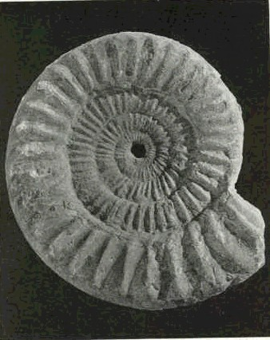
Ammonoids
Extinct
Devonian to Cretaceous
  400 to 65 MYA
Died out with dinosaurs

Slide 63
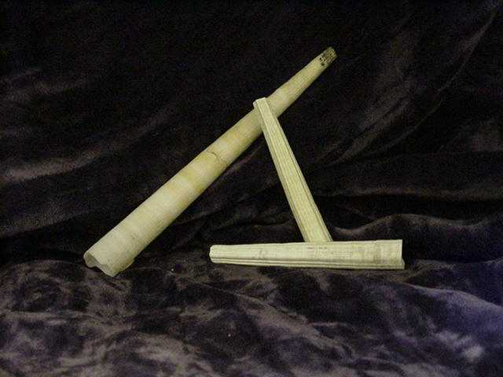
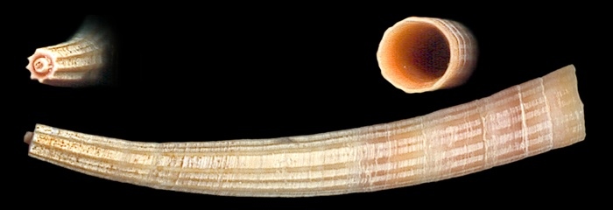
Class Scaphopoda
Tooth shells
Shell opens on both ends
Burrow into mud
No gills
  Mantle for gas exchange
Feed on detritus and protozoa

Slide 64
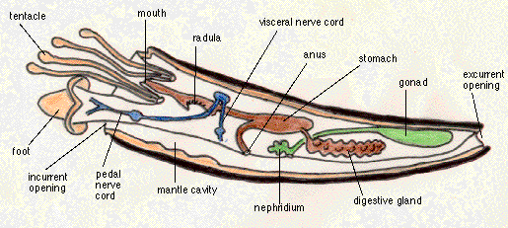
Class Scaphododa

Slide 65

The End

